Slide 1
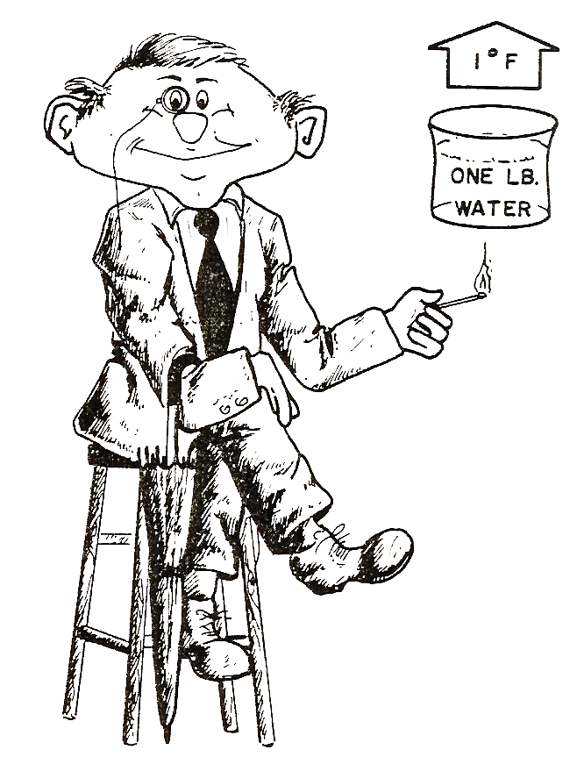
Module 1: Basic Refrigeration
Index:
Heat Energy
Heat Transfer
Pressure
Temperature

Slide 2
There are five basic laws of nature that we will be referring to throughout this module.
Law 1: Heat exists in the air at all temperatures.
Law 2: Heat flows from a higher temperature to a lower temperature.
Law 3: All gases become warmer when compressed.
Law 4: Matter can exist as a solid (ice), liquid (water), or gaseous (vapor) state.
Law 5: The temperature a material changes states depends on the pressure of the container.
Notes:
5 Bullet points coming in.

Slide 3
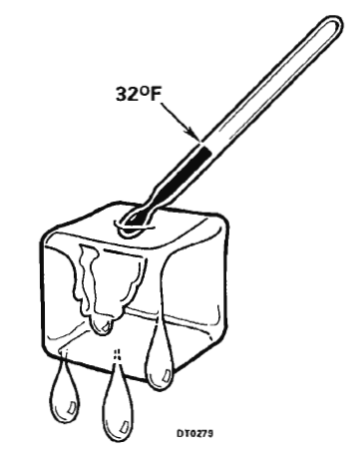
Refrigeration is the process of removing heat – so we need to understand heat.

Slide 4
Heat Energy
Simply put, heat is a measurement of energy.
It’s the vibrational energy of the molecules.
If We Double the Molecules
Water Droplet
We Double the Amount of Heat
Doubling Heat Does Not Double Temperature
Notes:
mechanical energy, electrical energy, chemical energy

Slide 5
Temperature
Heat level or intensity of the vibration.
The hotter an object is, the faster the motion of the molecules inside it.

Slide 6

Temperature
Heat level or intensity of the vibration.
The hotter an object is, the faster the motion of the molecules inside it.
Lower Temperature
Higher Temperature
Temperature IS NOT the amount of heat in a substance.

Slide 7
BTU – British Thermal Unit

Slide 8
Review # 1
The term BTU is an acronym for ______________ and is defined as _________.
British Temperature Unit, the amount of heat needed to raise 1 gallon of water 1 degree Celsius
British Thermal Unit, the amount of heat needed to raise 1 lb. of water 1 degree Fahrenheit
Bavarian Thermal Unit, the amount of heat needed to raise 1 lb. of water 1 degree Fahrenheit
None of the above

Slide 9
Transfer of Heat
Heat ALWAYS flows from a higher temperature to a lower temperature.
The rate of heat transfer is influenced by three factors:
Temperature Difference
Surface Area
Material Conductivity.
Notes:
Heat always travels from the hotter to the colder substance. If a hot piece of iron is dropped into a cup of cold water, the water will be warmed by the transfer of heat until both the water and the iron are at the same temperature. The faster moving molecules of the iron collide with the slower moving molecules in the colder substance, water, and give up a portion of their energy. The faster molecules slow down and the slower molecules speed up. This reduces the difference in relative speed between them. This continues until all molecules are moving at the same speed.
In other words, hot substances will give up heat to colder substances around them until the temperature of all becomes uniform, just as water always seeks a common level.

Slide 10
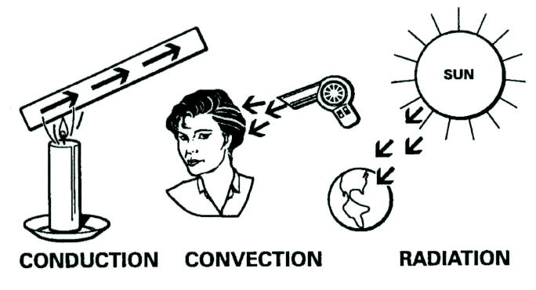
Transfer Methods
Notes:
Heat always travels from the hotter to the colder substance. If a hot piece of iron is dropped into a cup of cold water, the water will be warmed by the transfer of heat until both the water and the iron are at the same temperature. The faster moving molecules of the iron collide with the slower moving molecules in the colder substance, water, and give up a portion of their energy. The faster molecules slow down and the slower molecules speed up. This reduces the difference in relative speed between them. This continues until all molecules are moving at the same speed.

Slide 11

Conduction
Transferred by means of molecular agitation within a material without any motion of the material.

Slide 12
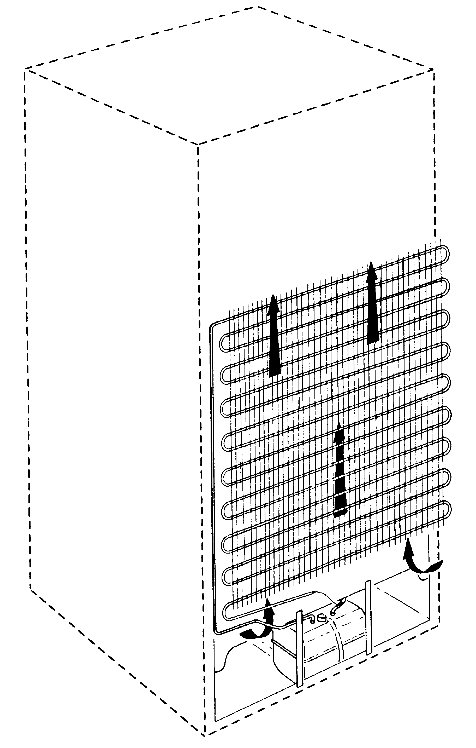
Convection
Heat moved through a medium, such as water or air.
A static condenser (pictured) on the rear of a refrigerator is a good example of the convection method of heat transfer. As cool air passes over the warm condenser, it picks up heat.
Convection
Notes:
Convection above a hot surface occurs because hot air expands, becomes less dense, and rises. Hot water is likewise less dense than cold water and rises, causing convection currents which transport energy

Slide 13
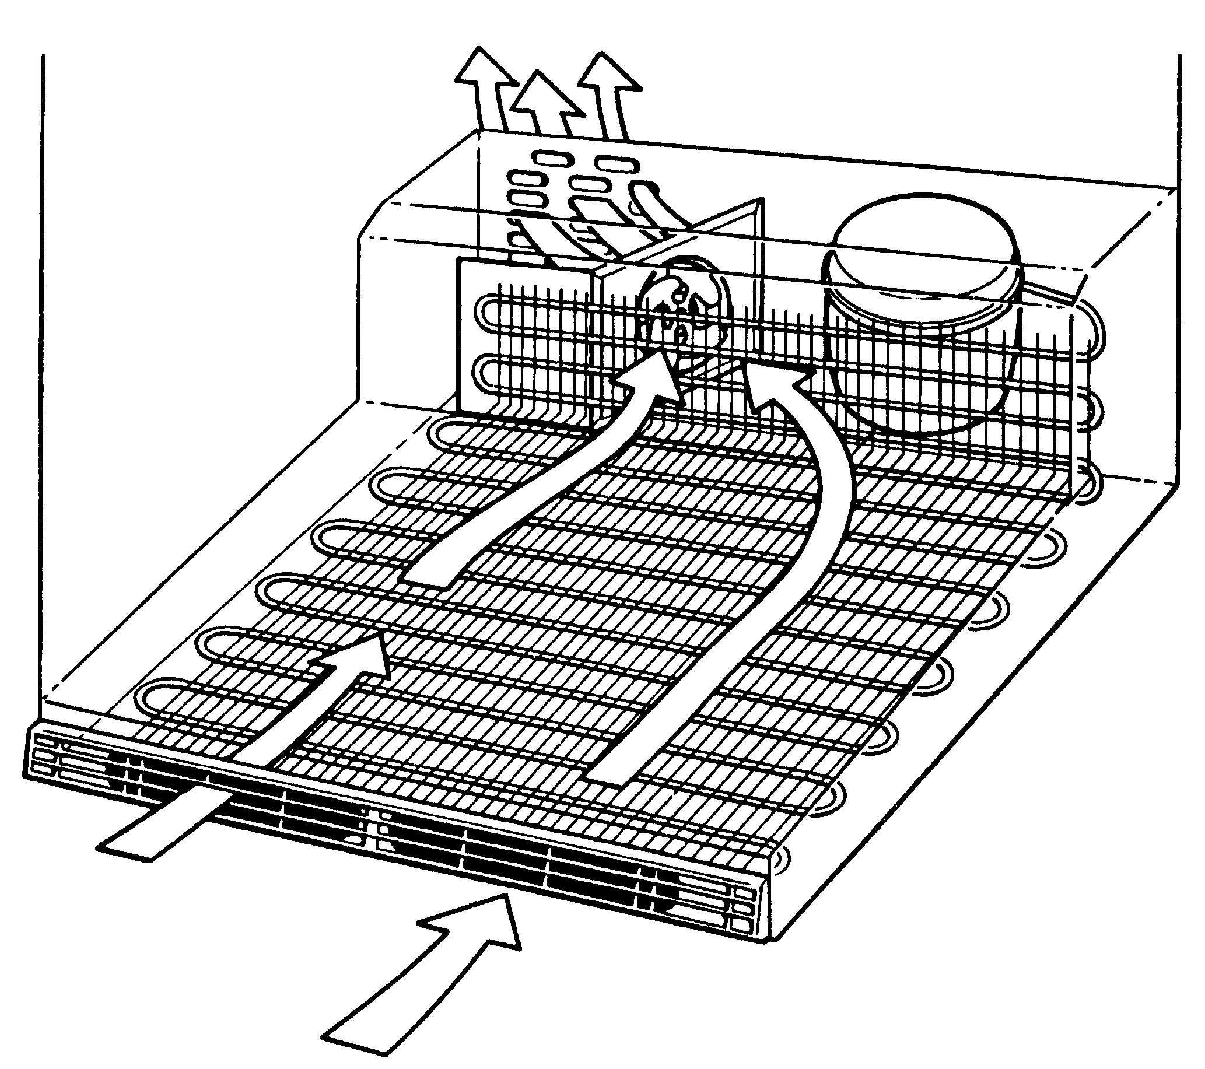
Forced Convection
Convection Assisted by a Circulating Device
Notes:
.. By circulating the medium, be it air or water, past the object to be heated or cooled, we can expose a greater number of molecules to collide and provide a transfer of heat.
In forced heat convection, transfer of heat is due to movement in the fluid which results from many other forces, such as a fan or pump. A convection oven thus works by forced convection, as a fan which rapidly circulates hot air forces heat into food faster than would naturally happen due to simple heating without the fan.
In refrigerators, we use a fan and circulate air as the transfer medium. In some air conditioners, we may elect to use water and use a pump for circulation. This form of heat transfer is not considered a separate type but rather a modification of the convection form. It has been given the name Forced Convection.

Slide 14
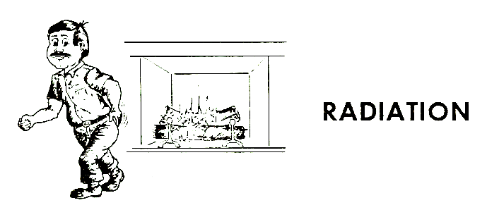
Radiation
Heat is transferred from one object to another by radiation without changing the temperature of the medium between the two objects.
Notes:
Radiation can take place even in a
perfect vacuum.

Slide 15
Review # 2
Module 1: Convection is best described as:
Heat transfer
Temperature difference between hot and cold
Heat from the sun
A heat transfer medium such as air or water to transfer the heat.

Slide 16
Review # 2
Radiation is best described as:
Heat transfer such as by the sun to the earth
Heat transfer with the use of a fan.
Heating of a cooler object by any means.
Conveying heat with movement.

Slide 17
Review # 2
Conduction is best described as:
Heat transfer utilizing a fan
Heat transfer within a material without any motion from the material
Heat energy
The least effective means of heating

Slide 18
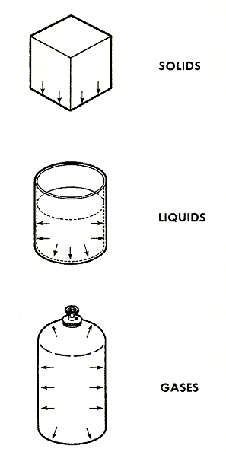
Forms of Matter
Notes:
A solid is any physical substance which retains its shape even though it is unsupported. It’s made up of billions of molecules, all exactly the same size, weight, and shape. They stay in the same location and constantly vibrate back and forth. The rate of vibration depends on the temperature. The lower the temperature, the slower the molecules vibrate. The higher the temperature, the faster they vibrate. These molecules are strongly attracted to each other and considerable force is necessary to move them.
A liquid is any substance that will assume the shape of its container (sides and bottom) and its molecules are also strongly attracted to each other. These molecules can be pictured as swimming among each other but never leaving. As the temperature rises, the molecules swim faster and the warmer molecules move upward toward the top of the container.
A gas is any substance which must be contained in a sealed container or it will soon dissipate. The molecules have little or no attraction for each other or any other substance and will uniformly fill any container in which they are placed.

Slide 19
Forms of Matter
Any molecule can be made to vibrate, swim, or fly depending on two things – temperature and pressure.
This phenomenon is known as a change of state.

Slide 20
Changes of State
The 4 Changes of State:
Melting - changing from a solid to a liquid
Fusion - changing from a liquid to a solid
Vaporizing (or evaporation) - changing from a liquid to a vapor
Condensing (or condensation) - changing from a vapor to a liquid

Slide 21
Changes of State
Most substances can exist in the solid, liquid, or gaseous state and can be changed from one state to another by adding or removing heat.

Slide 22
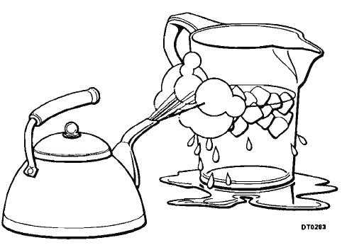
Changes of State
A refrigeration system is dependent upon the refrigerant changing state.
The two changes of state of prime importance are evaporation (liquid to a vapor) and condensation (vapor to a liquid).

Slide 23
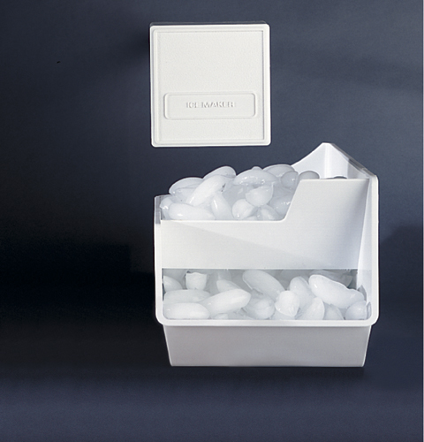
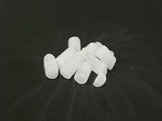
Sublimation
A solid changing directly to a vapor state – bypassing liquid state.
Sublimation causes freezer walls and shelves to remain free of ice, although ice-cubes will continually sublime.
Sublimation
Notes:
Frost-free freezers work by having a fan and air circulation inside the freezer. The below zero temperature combined with the air circulation that keeps the air arid significantly accelerates the sublimation process.

Slide 24
3 Types of Heat
Specific Heat – The relationship between heat energy and temperature of a substance.
Sensible Heat – Heat that can be measured with a thermometer.
Latent Heat – Hidden heat that cannot be measured with a thermometer.

Slide 25
Specific Heat
Every substance has a specific heat value:
Water – 1 BTU raises 1 lbs. of water 1° F.
Copper - .092 BTU raises 1 lbs. of copper 1° F.
Concrete - .2 BTU’s raises 1 lbs. concrete 1° F.

Slide 26
Specific Heat
If a pound of water absorbed 20 Btu, its temperature would rise 20 degrees F.
If a pound of copper absorbed the same 20 Btu its temperature would rise 217 degrees F.

Slide 27
Sensible Heat
Heat which causes a change in the temperature of a substance.
If one pound of water at 60°F is heated to 90°F, the change in temperature can be detected with a thermometer or by feeling the water.
Thirty (30) BTUs have been added, which is sensible heat.
A gallon of water and a quart of water may both be at the same temperature, but the gallon of water will contain more heat energy because it has four times the volume.

Slide 28
Latent Heat
Heat which brings about a change of state with no change in temperature – AKA hidden heat because it cannot be measured with a thermometer.
Heat energy causes the substance to change states:
Ice to Water – Heat added but temp remains at 32°.
Water to Steam – Heat added but temp remains at 212°.
Steam to Water – Heat removed but temp remains at 212°.

Slide 29
Review # 3
Most matter can be in the form of?
Gas, heat and mass
Solid, liquid and gas
Solid, liquid and energy
Conduction, convection and radiation

Slide 30
Review # 3
Module 1: Latent heat is:
Heat used to change a state from solid to liquid but not visible on a thermometer
Heat that changes state from convection to radiation
Heat that actually cools more than it heats.
All of the above

Slide 31
Review # 3
Sensible heat:
Is the same as latent heat
Can be measured with a thermometer
Can only be measured in Fahrenheit
Is expressed in BTU’s.

Slide 32
Pressure
Pressure is a measurement of how hard something is pushing against a given area.
Materials always exert pressure on the surfaces supporting or containing them.

Slide 33
Pressure
A solid exerts pressure downward on what ever is supporting it.
A liquid exerts pressure on its container sides and bottom.
A gas exerts pressure on all sides of its container.

Slide 34
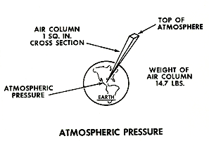
Atmospheric Pressure
A pressure of 14.7 psi has been adopted as the pressure exerted at sea level by the weight of a one square inch column of air having an altitude equal to the full depth of the atmosphere (approximately 600 miles).

Slide 35
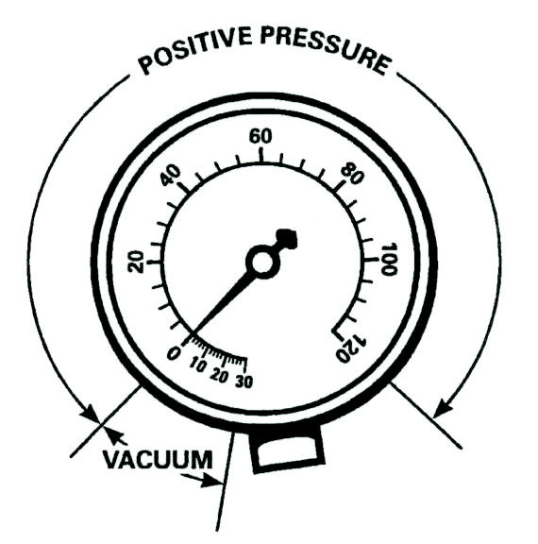
Gauges
Compound Gauge - reads pressures above and below atmospheric pressures.

Slide 36
Gauges
Above atmospheric pressure (0psig), the gauge is calibrated to read in pounds per square inch gauge.
Below atmospheric pressure, it is calibrated to read in inches of mercury (Hg) vacuum (0” - 30’ Hg).

Slide 37
Gauges
Above atmospheric pressure (0psig), the gauge is calibrated to read in pounds per square inch gauge.
Below atmospheric pressure, it is calibrated to read in inches of mercury (Hg) vacuum (0” - 30’ Hg).

Slide 38
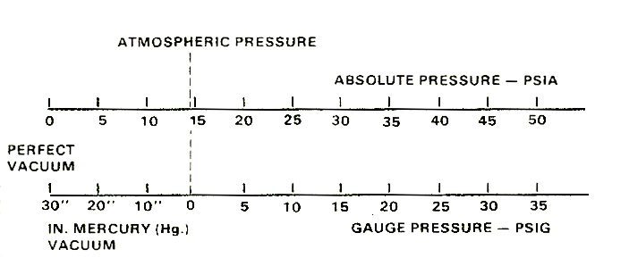
Absolute vs. Gauge Pressure
PSIA
14.7 PSI
PSIG
Pressure below atmospheric pressure (0 psig) but greater than absolute zero (30” Hg vac.) is called a partial vacuum.

Slide 39
Pressure-Temperature Relationship
Boyle's Gas Law states:
“The volume of a gas varies inversely with the pressure providing the temperature remains constant”.
In other words, as the pressure of a gas increases, its volume decreases.
Ex - A gas compressed to half its original volume will have a pressure twice as great as that at which it started.

Slide 40
Pressure-Temperature Relationship
Law 5 states:
“The temperature at which a material changes from a liquid to a gas or from a gas to a liquid depends on the pressure at which it is contained.”
Ex. - Water boils at 212°F at atmospheric pressure. If the pressure is raised to 100 psig, the boiling point will be 338°F.
The reverse is also true. If we lower the pressure to 24“ Hg vacuum, the water will boil at 142°F.
Notes:
We talked about law five in the five laws of nature

Slide 41
Pressure-Temperature Relationship
This is the principle of the vacuum pump. The pressure is lowered to a deep vacuum where any droplet of moisture in the system will boil into a vapor and then be drawn out of the system.
Ex. – A jar of water pulled down to a 29.9" Hg vacuum will boil at 35°F.
The operation of a mechanical refrigerator or freezer is made possible by this pressure-temperature relationship.

Slide 42
Heat of Compression
Whenever a gas or vapor is compressed, its temperature rises even though little or no heat has been added.
The temperature rise is due to the concentration of the heat contained in the vapor.

Slide 43
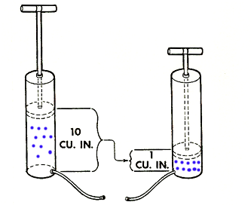
Heat of Compression
A good example of "heat of compression" is an ordinary hand tire pump.
Same thing happens in a refrigeration compressor on the compression stroke.
Notes:
As the air is pumped into the tire, the lower part of the pump will get very
hot. The heat energy contained in the larger volume of air When the
handle is up is compressed into a smaller volume at the end of the down
stroke. This concentrates the heat energy into a smaller area thereby
raising the temperature of the air.

Slide 44
Review # 5
Compound gauges:
Only read pressure above atmospheric pressure
Read pressure both above and below atmospheric pressure
Are used only on air conditioners
Only read high side pressures

Slide 45
Review # 5
A vacuum is best described as:
The same as atmospheric pressure
Another name for a micron
Any pressure below atmospheric and above absolute zero
A device used on floors

Slide 46
Review # 5
Lower pressure on water will cause it to
Boil at the same temperature as higher pressure
Boil at a higher temperature
It may never boil
Boil at a lower temperature

Slide 47
End of Presentation

